Slide 1

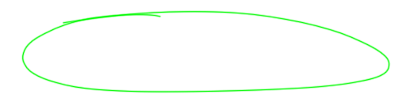
MARKET STRUCTURE OF MONOPOLY , DUOPOLY, PERFECT COMPETITION.
Here is where our presentation begins

Slide 2
Table of contents
01.
02.
03.
04.
05.
Introduction
Monopoly
Duopoly
Perfect competition
Conclusion

Slide 3


01.
Introduction
Provide a brief overview of what market structures are and why they are important in economics.

Slide 4


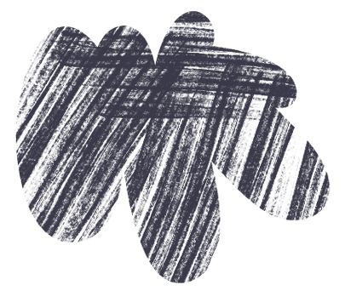
Introduction
Market structure refers to the organizational characteristics of a market, influencing the behaviour of firms within it and the outcomes for consumers. Three key market structures are monopoly, duopoly, and perfect competition, each representing different degrees of market concentration and competition.

Slide 5
02.
MONOPOLY
A Monopoly is a market structure that consists of only one seller producer.

Slide 6


MONOPOLY
A monopoly is defined as a single seller or producer that excludes competition from providing the same product. A monopoly can dictate price changes and creates barriers for competitors to enter the marketplace.

Slide 7

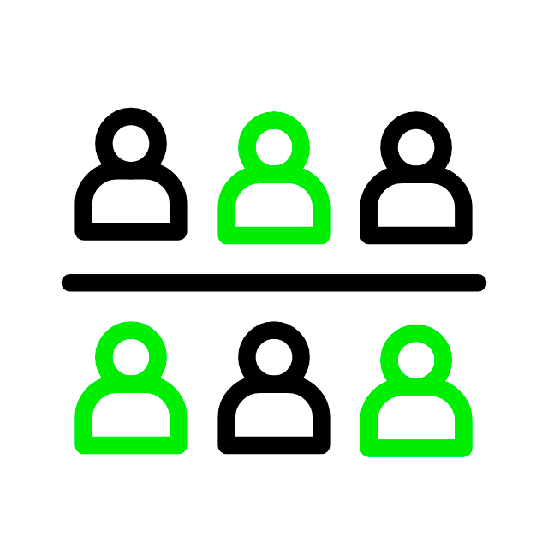

Types of Monopoly
Private monopoly
Public monopoly
Legal monopoly
One company dominates a market without significant competition.
Government or a public entity is the sole provider of a specific good or service.
Exclusive rights granted by law give a single entity the sole authority to produce or sell a particular product or service.

Slide 8
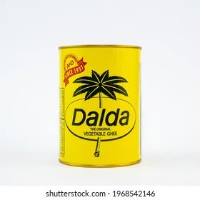
Private monopoly
A private monopoly occurs when a single privately-owned company controls a particular market niche to the extent that they wield significant power and influence over the market.

Slide 9


Public Monoploy
A government monopoly or public monopoly is a form of coercive monopoly in which a government agency or government corporation is the sole provider of a particular good or service and competition is prohibited by law.

Slide 10


Legal Monopoly
A government monopoly or public monopoly is a form of coercive monopoly in which a government agency or government corporation is the sole provider of a particular good or service and competition is prohibited by law.

Slide 11
03.
Duopoly
Duopoly involves two dominant firms in a market

Slide 12

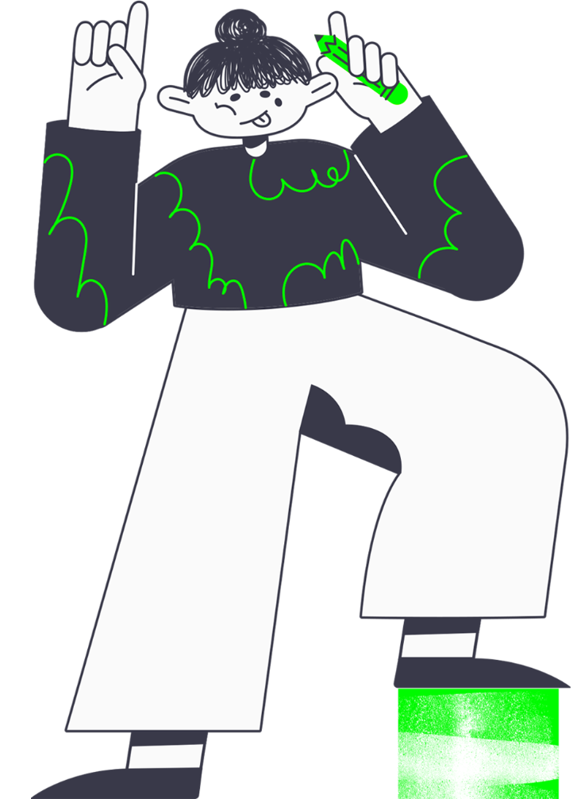
Duopoly
A duopoly is a situation where two companies together own all, or nearly all, of the market for a given product or service. A duopoly is the most basic form of oligopoly.

Slide 13
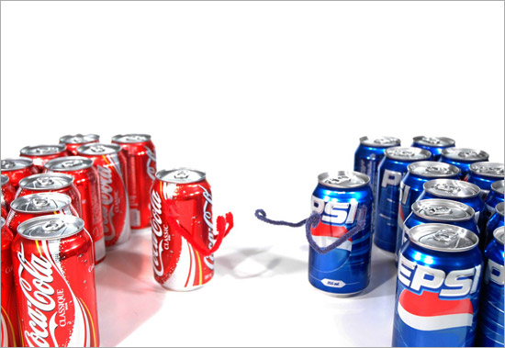

Slide 14
PERFECT COMPETITION
The term perfect competition refers to a theoretical market structure. Although perfect competition rarely occurs in real-world markets, it provides a useful model for explaining how supply and demand affect prices and behaviour in a market economy.

Slide 15

Types of perfect competition
Price Taker
Price maker
Mercury is the closest planet to the Sun
Venus is the second planet from the Sun

Slide 16

Types of perfect competition
Price Taker
A price-taker is an individual or company that must accept prevailing prices in a market, lacking the market share to influence market price on its own.

Slide 17

Types of perfect competition
Price maker
A price maker is a company that can dictate the price it charges for its goods because there are no perfect substitutes.

Slide 18

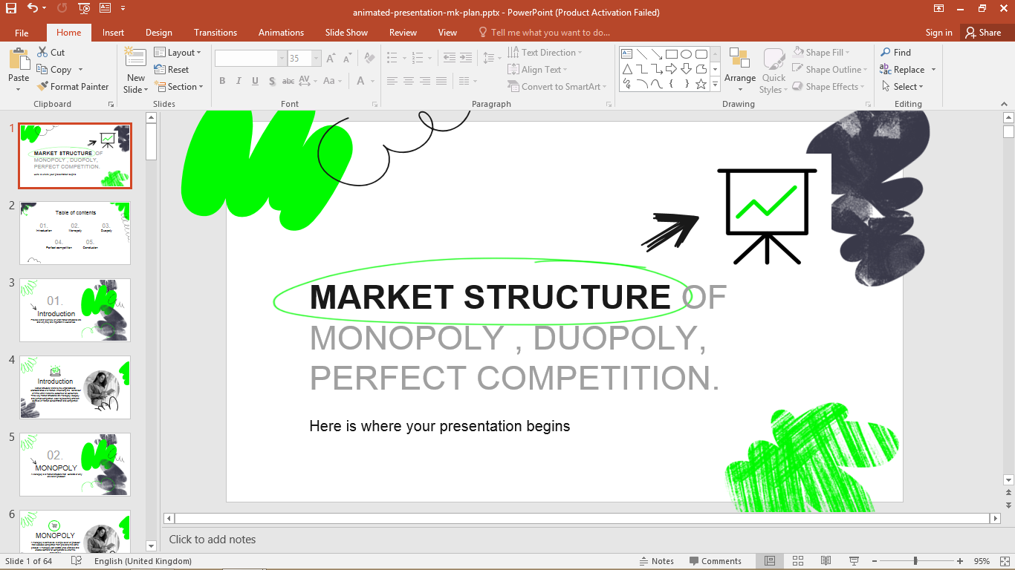
Conclusion
market structure defines the competitive landscape. Monopolies control, duopolies balance, and perfect competition aims for efficiency. Understanding these structures is vital for strategic business decisions and effective economic policies.

Slide 19
Thanks!

